Slide 2
Higher Education Learning Goals, Learning Strategies and 21st Century paradigms
Zafar A Reshi
Department of Botany, University of Kashmir
Srinagar

Slide 3
Lecture Plan
What are the goals of higher education?
What are the various types of learning strategies?
What are the requirements of 21st Century vis-à-vis higher education?
Which learning strategy/ies are appropriate to meet 21st century paradigms?
Take home message

Slide 4
Major goals of higher education?
Seven major goals
Achieving competence
Managing Emotions (including those that interfere with learning such as anger, anxiety, hopelessness and those that enable learning such as optimism, hopefulness)
Mature interpersonal relations (such as respecting differences and working with peers)

Slide 5
Major goals…….continued
Moving from autonomy to independence (including moving from needing assurance and approval of others to self-sufficiency)
Problem solving, and making decisions
Establishing identity including enhanced self-esteem and self-efficacy
Developing purpose (from who am I? and where am I? to where am I going?)

Slide 6
Out of these seven goals, let us pay some attention to:
Achieving competence

Slide 7
3Cs…….Competence, Competency and Confusion
Often a question is asked: Are competence and competency the same or different? Some dictionaries have represented the two interchangeably, i.e. meaning the same. For example:
Competence (noun). a. The state or quality of being adequately or well qualified; ability. See Synonyms at ability. b. A specific range of skill, knowledge, or ability (American Heritage Dictionary, 2006).
Competency (noun). The quality of being adequately or well qualified physically and intellectually (WordNet, 2006).
However, the meanings of competence and competency are not the same, but they mean two different meanings.

Slide 8
Competency vs Competence
Competency: A person-related concept that refers to the dimensions of behaviour lying behind competent performer.
Competence: A work-related concept that refers to areas of work at which the person is competent.
Competencies: Often referred to the combination of the above two.

Slide 9
COMPETENCY = COMPETENCE + COMMITMENT
Competence characteristics | Commitment characteristics
Technical knowledge Functional information Business knowledge Communication skills Interpersonal skills Leadership skills Team building skills Decision making skills Time management skills | Self confidence Self motivation Honesty and integrity Determination Positive attitude Winning attitude Learn from mistakes Perseverance Enterprising Result oriented
Competence = Knowledge × Skills
Commitment = one’s deep attachment or devotion with passion and faith or belief of a person on the job.
Competency = Knowledge × Skills + Commitment

Slide 10
Now we can have a definition of competence
A cluster of related abilities, commitments, knowledge, and skills that enable a person (or an organization) to act effectively in a job or situation.
Competence indicates sufficiency of knowledge and skills that enable someone to act in a wide variety of situations.
Please note:
Because each level of responsibility has its own requirements, competence can occur in any period of a person's life or at any stage of his or her career.

Slide 11
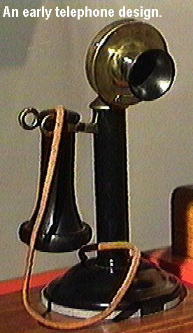
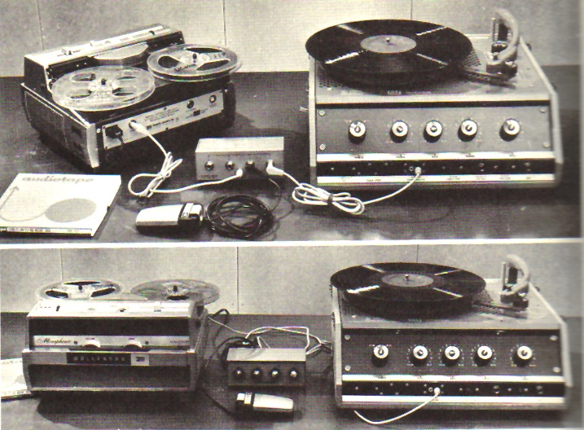
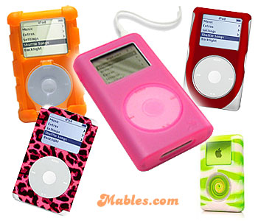
Competence in changing world
How has our world changed?
COMMUNICATION
ENTERTAINMENT

Slide 12
JOBS
METHODS OF PAYMENT
Notes:
iPod

Slide 13
What are the implications of these changes for the students?
Unprecedented access to information.
Myriad new ways to express their creativity.
Effortless global connectivity.
Academic choices and careers we can’t yet envision.

Slide 14
Under these changed circumstances present system of education faces irrelevance
Alarm was raised as early as 1983 in US and serious concerns were expressed in the following report submitted by the National Commission on Excellence in Education
A Nation at Risk: The Imperative for Educational Reform
Notes:
Marc Prensky 2001 Digital Natives, Digital Immigrants
They are the first generation to grow up with computers, videogames, digital music players, video cams, cell phones.
They are digital natives.
Accustomed to receiving information fast
Like to parallel process and multi-task
Prefer their graphics before their text
Prefer random access (like hypertext)
Function best when networked
Thrive on instant gratification and frequent rewards
Prefer games to “serious” work
Teachers are for the most part – digital immigrants
They came to the digital shores later in life, and they had to learn to cope with digital technology as adults.

Slide 15
Recommendations of the Report:
Five New Basics: English, Mathematics, Science, Social Studies, Computer Science (now STEM subjects)
Other Curriculum Matters: Develop proficiency, rigor, and skills in Foreign Languages, Performing Arts, Fine Arts, Vocational Studies, and the pursuit of higher level education
Skills and abilities

Slide 16
The SCANS for Skills
‘The Secretary’s Commission on Achieving Necessary Skills (SCANS) was appointed by the US Secretary of Labor to determine the skills the young people need to succeed in the world of work.

Slide 17
Beyond 3Rs
Research has found that the top skills demanded by U.S. Fortune 500 companies by the year 2000 had shifted from traditional 3Rs (reading, writing and arithmetic) to teamwork, problem solving, and interpersonal skills.

Slide 18
Major educational frameworks designed to improve the development of 21st century skills.
Partnership for 21st Century Skills
Iowa Core 21st Century Skills
Tony Wagner’s Seven Survival Skills
Metiri Group’s enGauge framework
Connecticut State Department of Education
Assessment and Teaching of 21st Century Skills (ATC21S)

Slide 19
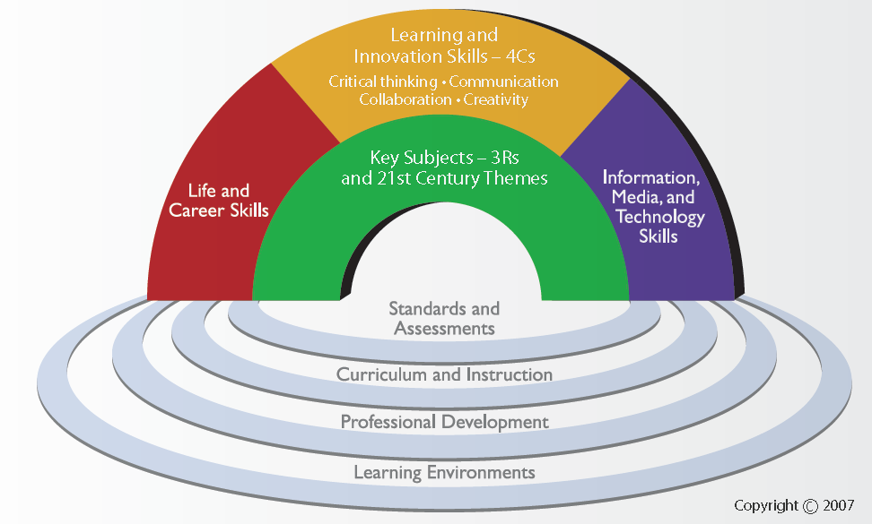

Slide 21
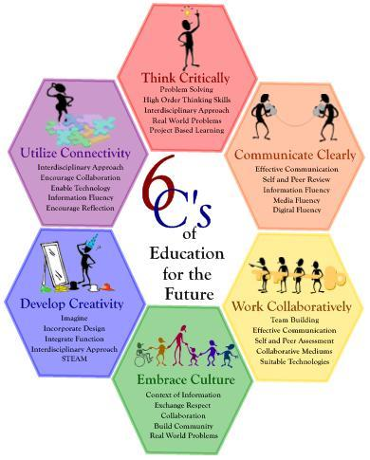

Slide 22
Critical 21st century skills
While each framework has slightly different list of skills, all agree on:
Creativity and imagination
Critical thinking
Problem solving
Collaboration and teamwork

Slide 23
How to inculcate these 21st Century Skills in our students?

Slide 24
Use of appropriate learning strategies
Hattie and Donoghue (2016) identified > 400 learning strategies. These strategies can be categorized in many ways according to various taxonomies and classifications.

Slide 25
Boekaerts (1997), for example, argued for three types of learning strategies:
Cognitive strategies, such as elaboration, to deepen the understanding of the domain studied.
Metacognitive strategies, such as planning, to regulate the learning process.
Motivational strategies, such as self-efficacy, to motivate oneself to engage in learning.
Given the advent of newer ways to access information (e.g. internet), Dignath et al. (2008) added a fourth category
Management strategies, such as finding, navigating and evaluating resources.

Slide 26
Learning strategies proposed by Marton and Saljo (1984)
Surface Learning
Deep Learning
Subsequently, a third strategy was added
Strategic Learning

Slide 27
Surface level learning
It tends to be associated with those learners who concentrate on memorising what the author wrote and/or lecturer said.

Slide 28
Examples of surface level learning characteristics
The learner is more or less forced to adopt a rote learning strategy.
Concentration is on routine fact memorisation which can give the impression that understanding has occurred.
Finding the ‘right’ answers .
Assimilating unaltered chunks of knowledge.

Slide 29
Surface learning from the student’s perspective
An intention only to achieve a minimal pass.
Non academic priorities exceeding academic ones.
Insufficient time; too high a workload.
Misunderstanding, such as thinking that factual recall is adequate.
A cynical view of education
High anxiety
A genuine inability to understand particular context at a deep level

Slide 30
Surface learning from the lecturer’s perspective:
Piecemeal teaching, not bringing out the intrinsic structure of the topic or subject
Assessing for independent facts, inevitably the case when using short-answer and multiple-choice tests
Providing insufficient time to engage in the tasks; emphasizing coverage at the expense of depth
Creating undue anxiety or low expectations of success

Slide 31
Deep level learning
It is associated with those learners who attempt to relate ideas together to understand the underpinning theory and concepts, and to make meaning out of material under consideration.
It is also associated with those learners who are able to understand authors’ and/or lecturers’ words enough to give a meaning using their own words.

Slide 32
Examples of deep level learning characteristics
Master core academic content
Think critically and solve complex problems
Work collaboratively
Communicate effectively
Learn how to learn
Develop an academic mindset

Slide 33
Deep learning from the student’s perspective
An intention to engage with the task meaningfully and appropriately. Such an intention may arise from an intrinsic curiosity or from a determination to do well.
Appropriate background knowledge .
The ability to focus at a high conceptual level, working from first principles, which in turn requires a well-structured knowledge base.
A genuine preference and ability for working conceptually rather than with unrelated detail.

Slide 34
Deep learning from the teacher’s perspective
Teaching in such a way as to explicitly bring out the structure of the topic or subject
Teaching to elicit an active response from students, e.g. by questioning and presenting problems, rather than teaching to expound information
Teaching by building on what students already know
Confronting and addressing students’ misconceptions

Slide 35
Deep learning from the teacher’s perspective
Assessing for structure rather than for independent facts
Teaching and assessing in a way that encourages a positive working atmosphere, so students can make mistakes and learn from them
Emphasising depth of learning rather than breadth of coverage
Using teaching and assessment methods that support the explicit aims and intended outcomes of the course

Slide 36
Strategic learning
In this approach learners organise their learning with the objective of achieving a high or positive outcome.
Strategic learning can involve a combination of both deep and surface learning strategies depending on the tasks at hand.
There are times in a learner’s life when it may serve them to be a strategic learner, for example, when they have large chunks of information to learn or when they are time-poor.
Strategic learning when closely allied with deep approaches to learning can deliver both success and good understanding of a subject.

Slide 37
Three approaches to learning
Surface learning | Deep learning | Strategic learning
Try to learn in order to repeat what they have learned | Actively seek to understand the material/the subject | Intend to obtain high grades
Memorise information needed for assessments | Interact vigorously with the content | Organise their time and distribute their effort to greatest effect
Take a narrow view and concentrate on detail | Make use of evidence, inquiry and evaluation | Ensure that the conditions and materials for studying are appropriate
Fail to distinguish principles from examples | Relate new ideas to previous knowledge | Use previous exam papers and assessments to predict questions
Tend to stick closely to the course requirements | Tend to read and study beyond the course requirements | Use marking criteria carefully
Are motivated by fear of failure | Are motivated by interest

Slide 39
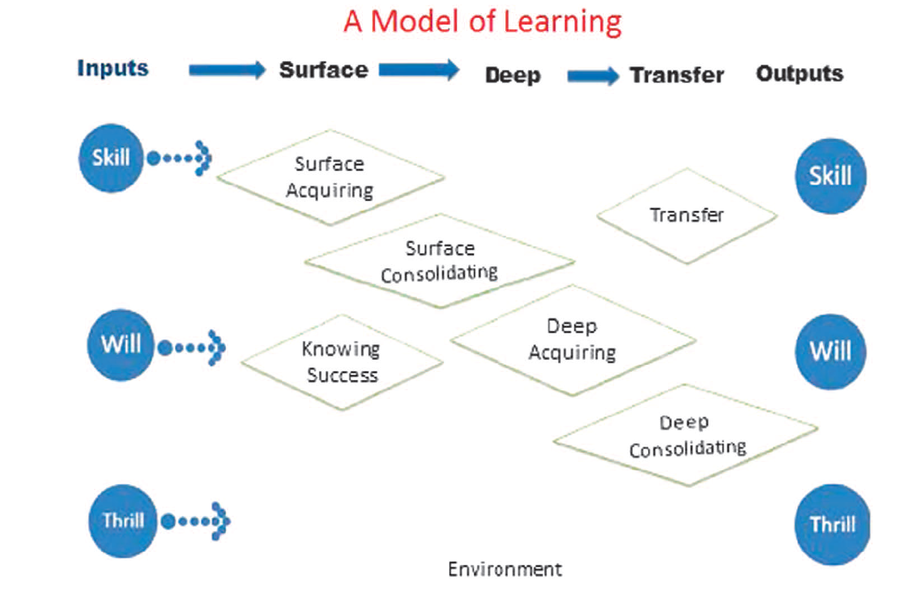
After Hattie and Donoghue (2016)

Slide 40
What this model proposes?
The model proposes that it is worthwhile to develop the skill, will and thrill of learning, and that there are many powerful strategies for learning.
Students can be taught these strategies (declarative knowledge), how to use them (procedural knowledge), under what conditions it may be more or less useful to apply them (conditional knowledge) and how to evaluate them.
It may be necessary to teach when best to use these strategies according the nature of the outcomes (surface and deep), according to the timing of learning (first acquiring and then consolidating learning) and to teach the skill of transferring learning to new situations.

Slide 41
What do we conclude?
We need to think in terms of ‘surface to deep’ and not one alone; we need to think in terms of developing dispositions, motivations and achievement, and not one alone
But Deeper learning competencies, particularly in higher education, result in students’ ability to use and apply what they have learned.
This ability, known as knowledge transfer, is widely recognized as critical to succeeding at novel tasks or new contexts.

Slide 42
Deeper learning competencies address three domains:
Cognitive
Interpersonal
Intrapersonal

Slide 43
Cognitive domain
Students develop a strong academic foundation in subjects like reading, writing, math, and science; understand disciplinary principles and concepts.
As students master content, they are more able to transfer knowledge to other situations or tasks and learn how to think critically.
They will have the ability to synthesize and analyze information.
Recognize patterns, trends, and relationships so they can identify and solve problems as well as assess or evaluate the effectiveness of the proposed solution(s).

Slide 44
Interpersonal domain
Students learn how to work collaboratively to complete tasks, produce shared work, and understand and solve complex problems.
They also learn how to effectively communicate complex concepts to others through a variety of modes of expression in a logical, useful, meaningful, and purposeful way.
For students to do this, they must learn how to clearly organize their data, findings, and thoughts.

Slide 45
Intrapersonal domain
Students learn how to monitor and direct their own learning, recognize what they know or do not know, recognize when and how they are confused, identify the obstacles or barriers to their success, and then determine and deploy strategies to address these challenges.
In developing an academic mindset, students are able to see themselves as academically successful and therefore trust in their own competence and feel a strong sense of efficacy.
As a result, students engage in positive and productive academic behaviors and persevere when they face difficulties.

Slide 46
Teaching for Deeper Learning
In order to prepare students for success in the 21st century, teachers must:
Empower students as learners
Contextualize knowledge so that it is coherent
Connect learning to real world experiences
Extend learning beyond the classroom
Inspire students by customizing learning experiences
Purposefully incorporate technology to enhance (not automate) learning

Slide 47
NEW ROLES FOR TEACHERS CREATED BY DEEP LEARNING
learning strategist
learning designer
facilitator
networker
coach, counselor, or mentor

Slide 48
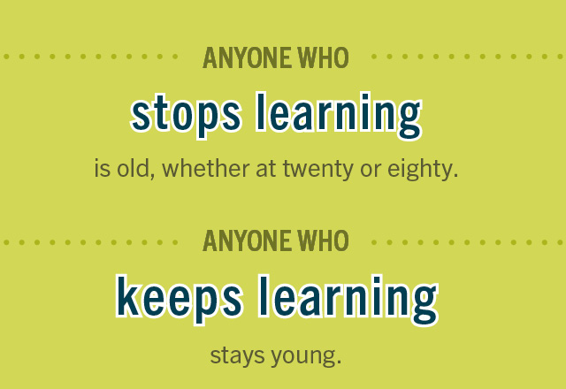
Epilogue

Slide 49
Thank you for your attention

